Slide 1
Modular Programming(7-dars)
Davronbek Malikov

Slide 2
Bugun
Oraliq: Xulosa
Project 3 xolati va savol javob
Takrorlash
Loading data
Pipeline
Pipeline: Amaliy
Vazifa

Slide 3
Oraliq: Xulosa

Slide 4
Oraliq: Xulosa
Modullar
Git bash(folder+file)
Git + Local+ Vis code+ Github
Standalone+ichki git bash
Virtual Env
Data Extraction, Merging
Logging
Katta datasetlarni yuklash
Umumiy 2 ta Project

Slide 5
Project 3 xolati va savol javob

Slide 6
Takrorlash

Slide 7
Takrorlash
Project 2 xolati+ Savol javob
Takrorlash
Logging va error(Theory)
Logging va error(amaliy)
Katta file va datasetlarni githubga push qilish
Data loading + log(project)
Vazifa va Project

Slide 8
Loading data

Slide 9
Loading Data
Oddiy usul:
  Logsiz
  Logli
Class:
  src+ipynb(oson , data analysis, pipeline uchun ideal emas)
  src+scripts(industry level)

Slide 10
Loading data using class
Toza va tartibli koding uchun kerak boladigan jarayon
Kerakli papkalar:
  src+ notebook
  src+scripts
Kerakli ishlar:
  Pip install pickleshare
  __init__.py(src)
    Folder -> package
    Subfolder allows
    control

Slide 11
Pipeline

Slide 12
Pipeline
Mustaqil bo’lgan bir nechta qismlarni malum bir vazifa uchun ketma ket birlashish jarayoni
Pipelineda birinchi xolatning output ozindan keying
jarayon uchun input boladi

Slide 13
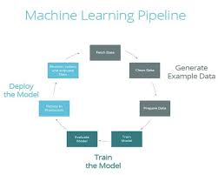
Pipeline
Pipelineda xar bir qism(model) malum bir ishni bajaradi
Key Features:
  Modularity
  Resubility
  Clear Separation of concerns

Slide 14
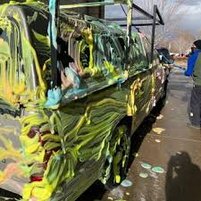
Pipeline
Car wash
  Oldin oddiy suv bn yuviladi
  Sovun/kopik
  Cho’tka
  Suv
  Quritiladi
Xar bir qism alohida xam kuchga ega ulardan birini olib tashlasak yoki o’rnini almashtirsak xam kuchga / manoga ega

Slide 15
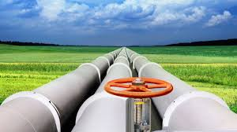
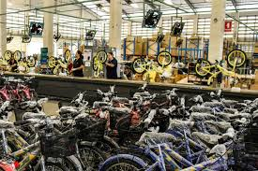
Pipeline

Slide 16
Pipeline
Qanday foydasi bor
Tushunarli va toza workflow
Ason xatolarni topish
Qayta ishlatsa boladigan kodlar blogi
Team azolari alohida project qismlari bn ishlash imkoniyati borligi

Slide 17
Pipeline: Amaliy

Slide 18
Vazifa
7-darsimiz uchun report yozing
Alohida kichik ipynb fileda:
  Python bo’yicha 4 ta pipeline yasang

